Slide 1
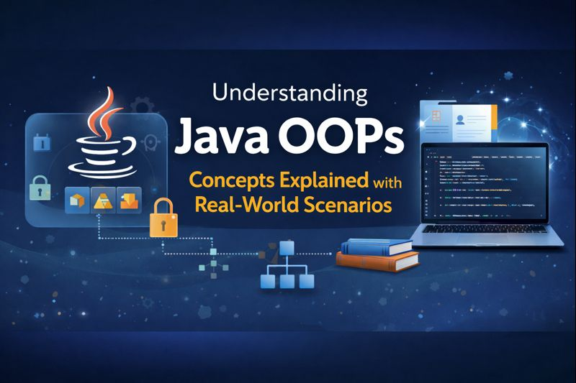

Slide 2


What is object?

Slide 3



Slide 4
What is Class?

Slide 5

Objects and Classes

Slide 6
package naren.java.helpline; class Addition { public int add(int n1, int n2) { return n1 + n2; } } public class ObjectAndClassDemo { public static void main(String[] args) {
Addition obj = new Addition(); System.out.println(obj.add(20, 30)); } }

Slide 7
Four Pillars of OOPs in Java
Encapsulation
Inheritance
Encapsulating data and methods within an object to ensure data security and code integrity.
Creating new classes by inheriting properties and behaviors from existing classes.
Polymorphism
Abstraction
Having multiple forms of a method or class, allowing flexibility and adaptability in code.
Using abstract classes and interfaces to define common behaviors and properties without implementing them.

Slide 8
👉 “Eat Ice-cream, Play Alone” 🍦🎮
Eat → Encapsulation
Ice-cream → Inheritance
Play → Polymorphism
Alone → Abstraction

Slide 9

Encapsulation?

Slide 10
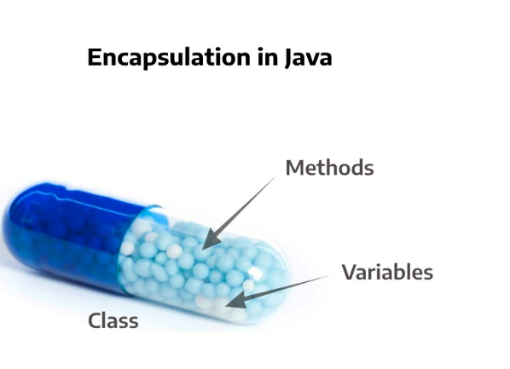

Slide 11
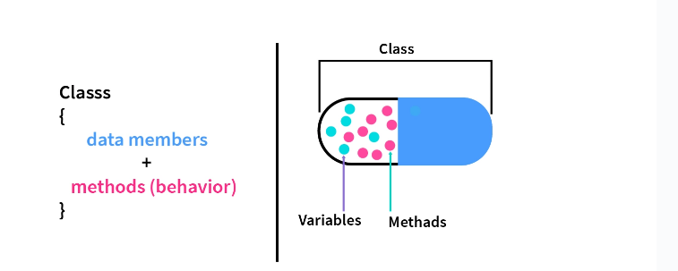

Slide 12
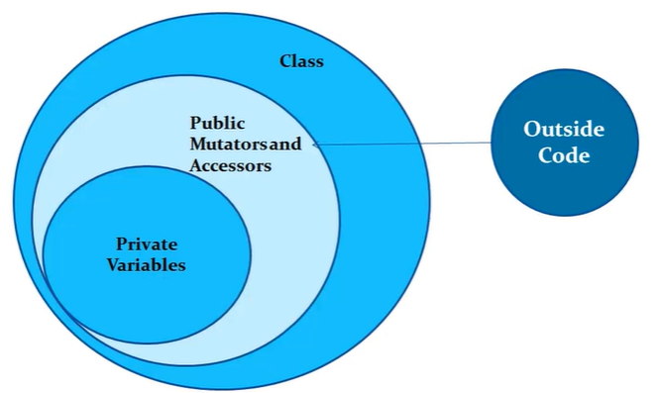

Slide 13
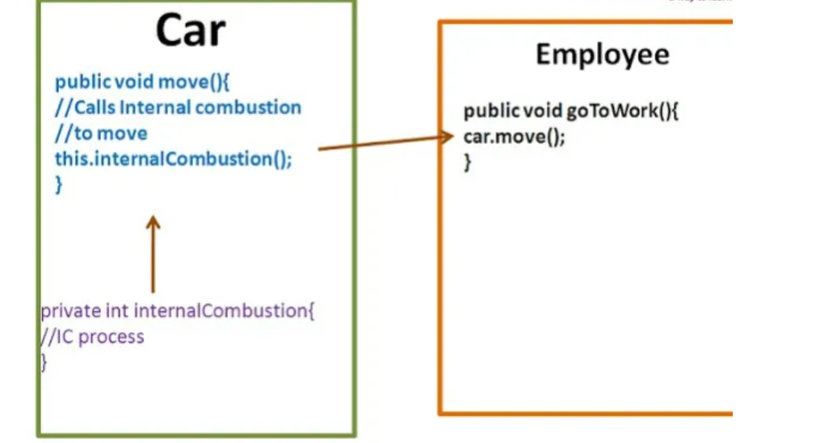

Slide 14
package naren.java.helpline; class BankAccountEncapsulationDemo { private double balance; public double getBalance() { return balance; } public void deposit(double amount) { if(amount > 0) { balance += amount; } } }

Slide 15
Abstraction?

Slide 16
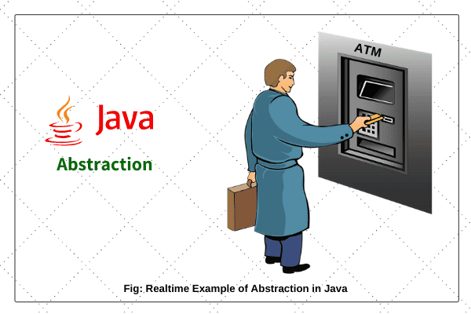

Slide 17
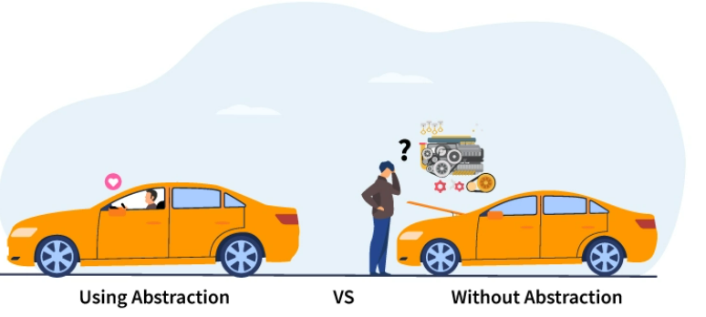

Slide 18


Slide 19
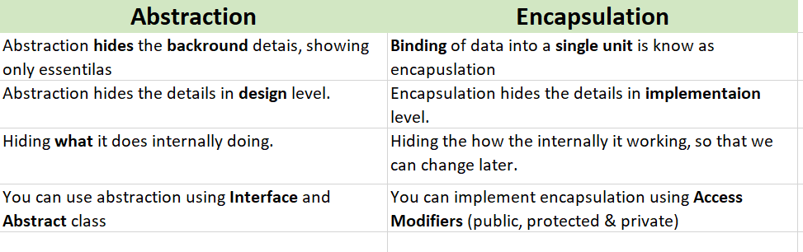

Slide 20

What is Inheritance?

Slide 21

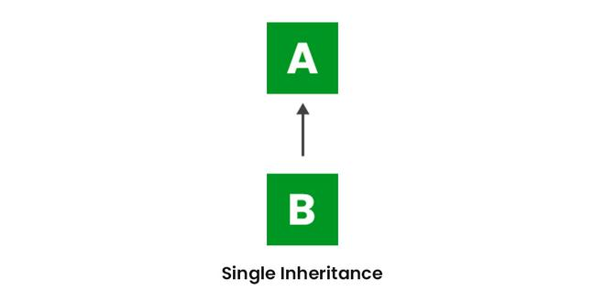

Slide 22
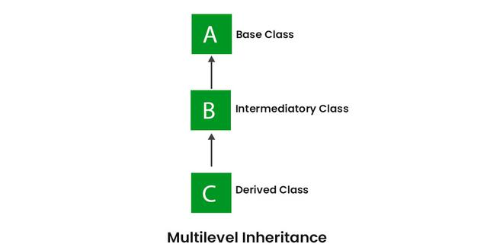

Slide 23
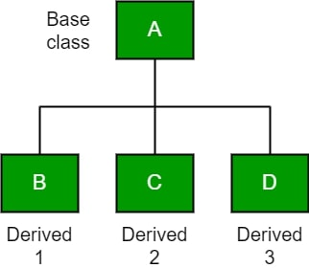
Hierarchical Inheritance

Slide 24
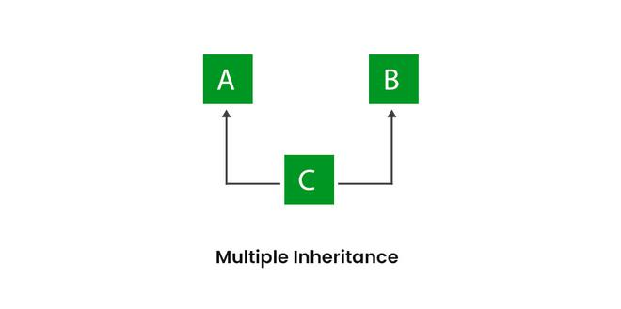

Slide 25
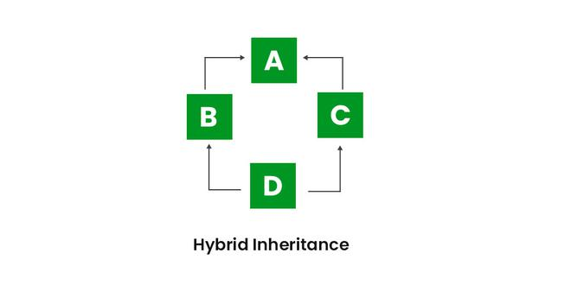

Slide 26


Slide 27


Slide 28
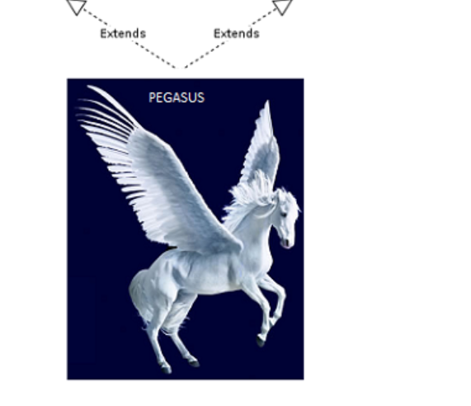


Slide 29


Slide 30
Inheritance Demo
package naren.java.helpline; interface Car { int speed=50; public void run(); } class TataNexonBasic implements Car { int speed=100; @Override public void run() { System.out.println("Running in the speed of 100K/h"); } public void abc() { System.out.println("I am from TataNexonBasic class-abc()"); } } class TataNexonXzaPlus extends TataNexonBasic { int speed=150; @Override public void run() { System.out.println("Running in the speed of 150k/h"); } }
class TataSports extends TataNexonXzaPlus { //int speed=300; @Override public void run() { System.out.println("Running in the speed of 300km/h"); } } public class DemoInheritance { public static void main(String[] args) { TataSports car = new TataSports(); car.run(); //car.abc(); //System.out.println("Speed: "+ car.speed); } }

Slide 31
Inheritance Diamond Problem
package naren.java.helpline;
interface A {
default void fun() {
System.out.println("I am from A");
}
}
interface B {
default void fun() {
System.out.println("I am from B");
}
}
class D implements A, B {
@Override
public void fun() {
// TODO Auto-generated method stub
B.super.fun();
}
}
public class Demo4 {
public static void main(String[] args) {
D obj = new D();
obj.fun();
}
}

Slide 32
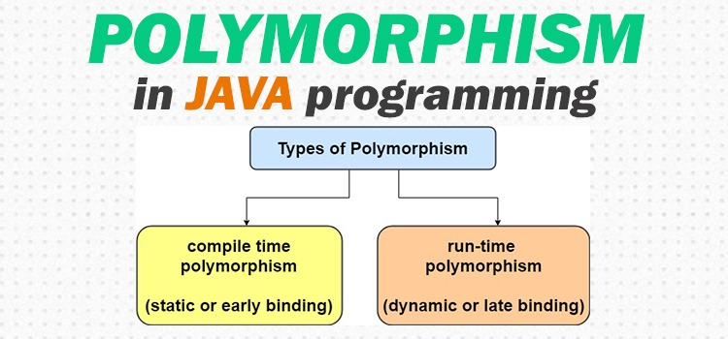

Slide 33
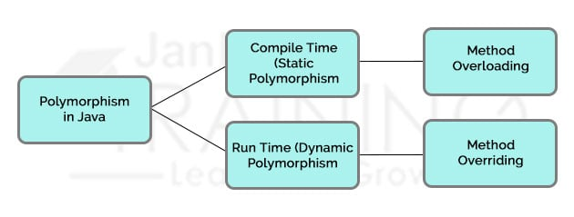

Slide 34
Polymorphism Demo
package naren.java.helpline;
class Calculator {
public int add(int n1, int n2) {
return n1 + n2;
}
public double add(double n1, double n2) {
return n1 + n2;
}
public double add(double n1, int n2) {
return n1 + n2;
}
public int add(int n1, int n2, int n3) {
return n1 + n2+ n3;
}
}
public class PolyDemo {
public static void main(String[] args) {
Calculator calc= new Calculator();
System.out.println(calc.add(4, 3));
System.out.println(calc.add(4,3,10));
System.out.println(calc.add(40d, 5d));
System.out.println(calc.add(40d, 20));
}
// Method overloading?
// method name is same
// the nmuber of parameter is diffrent
// order of paramters is diffrent
// types of paramyter is diffrent
}

Slide 35
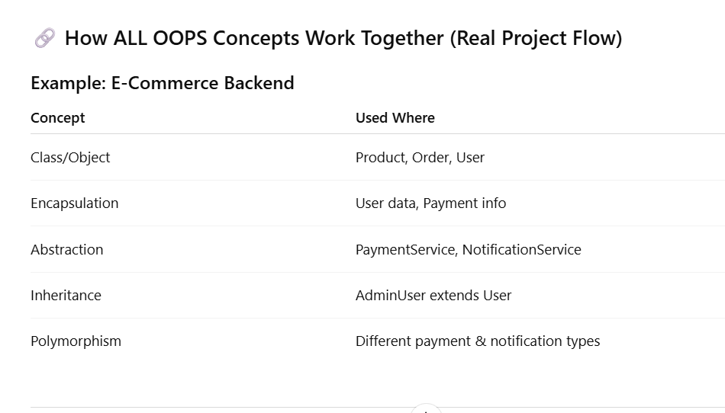

Slide 36
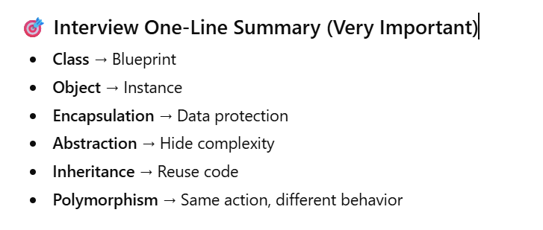

Slide 37
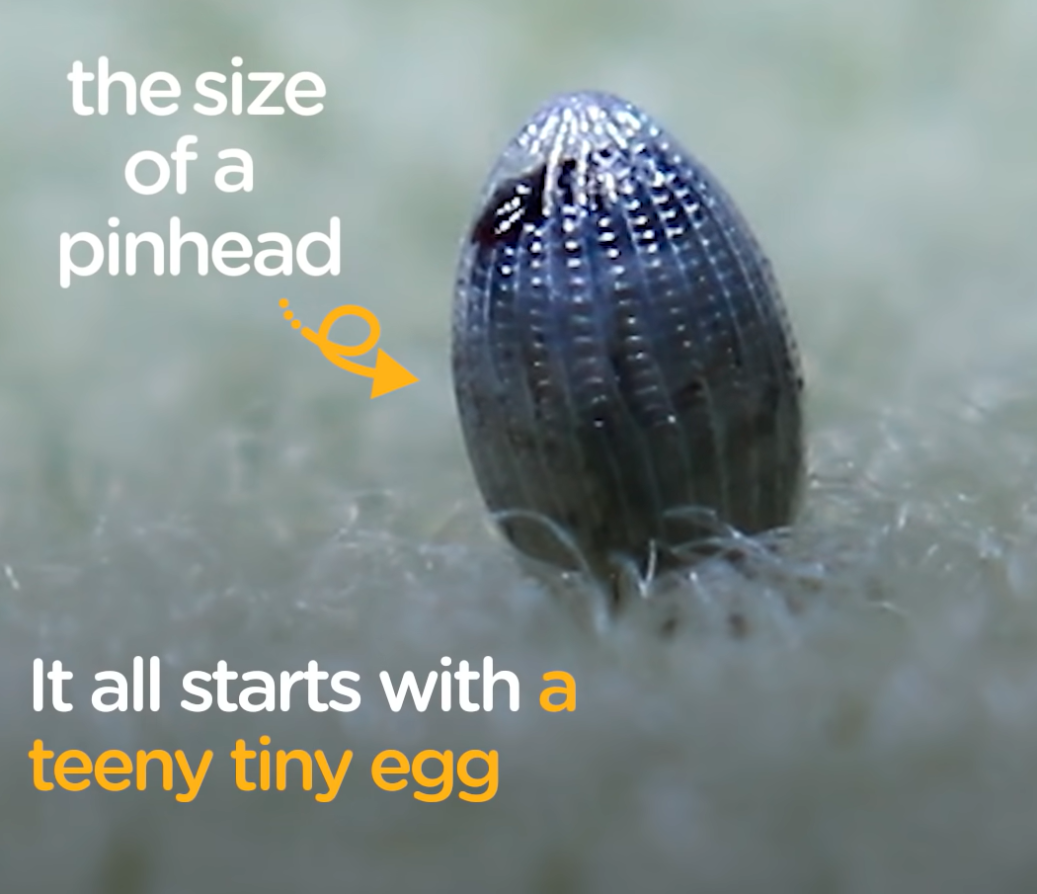

Slide 38
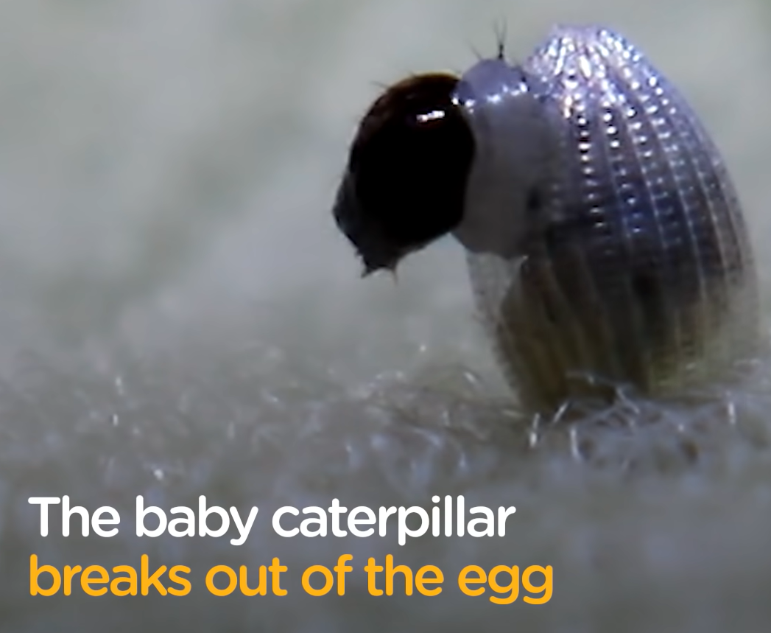

Slide 39
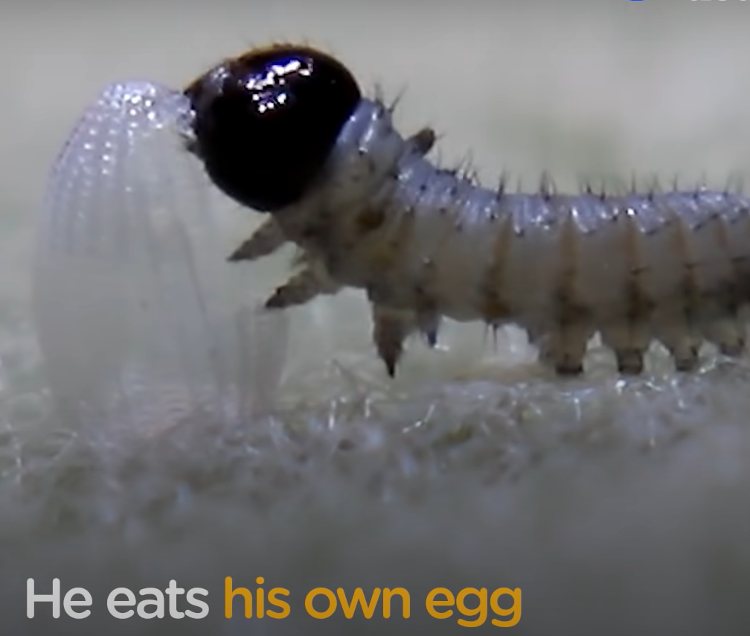

Slide 40
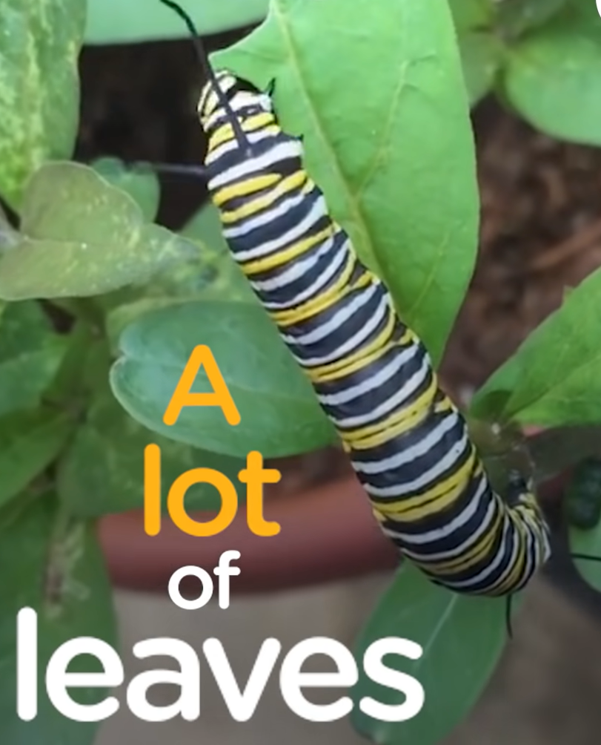

Slide 41


Slide 42
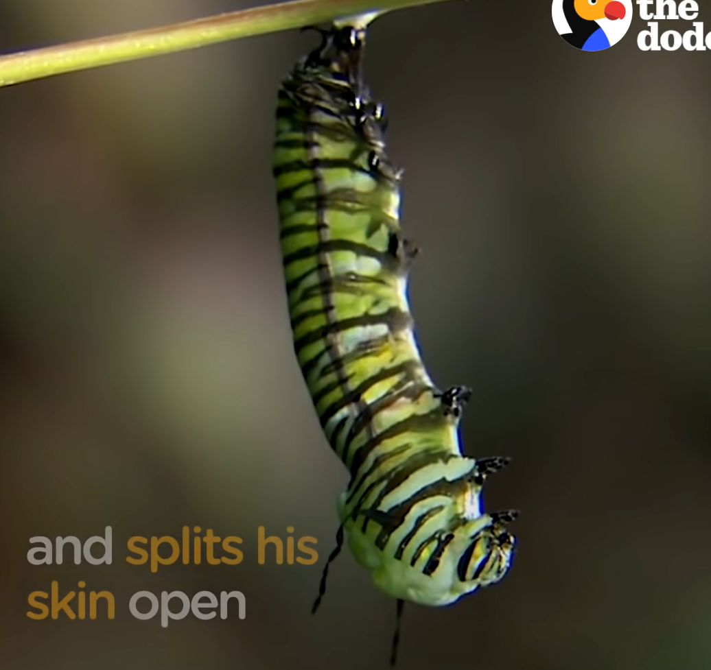

Slide 43
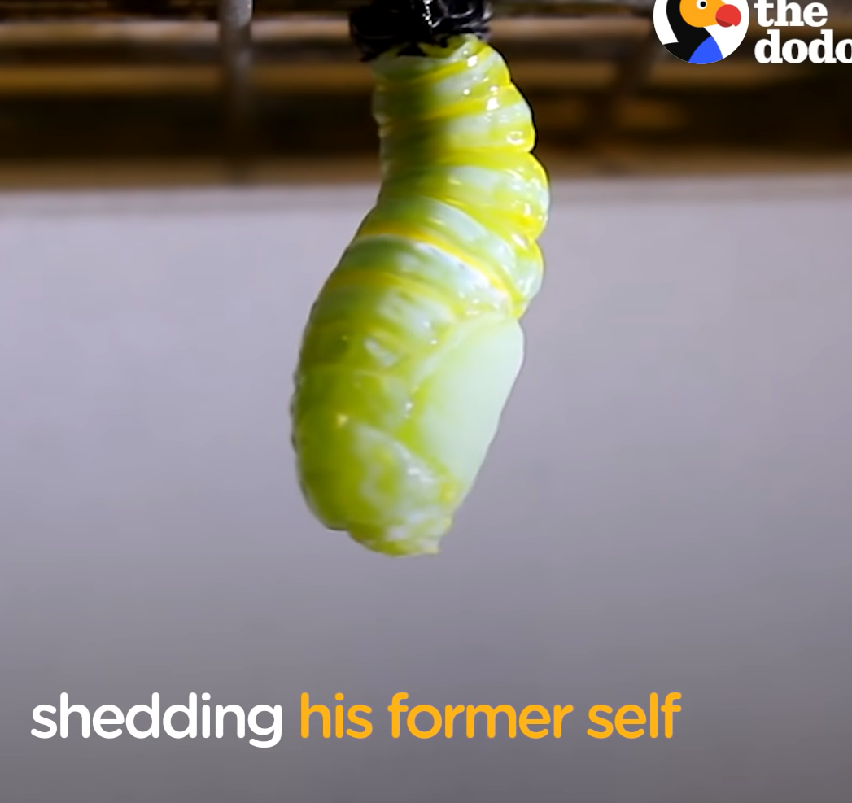

Slide 44


Slide 45


Slide 46


Slide 47
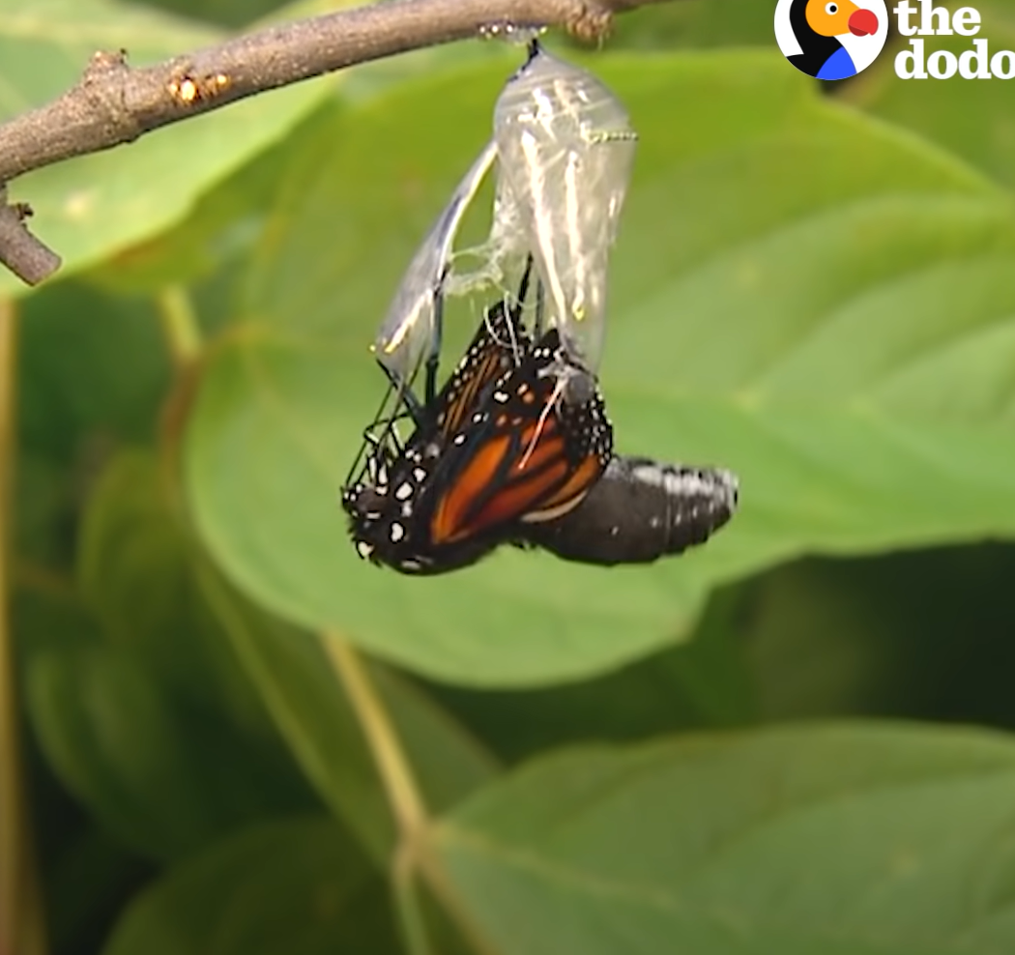
v

Slide 48
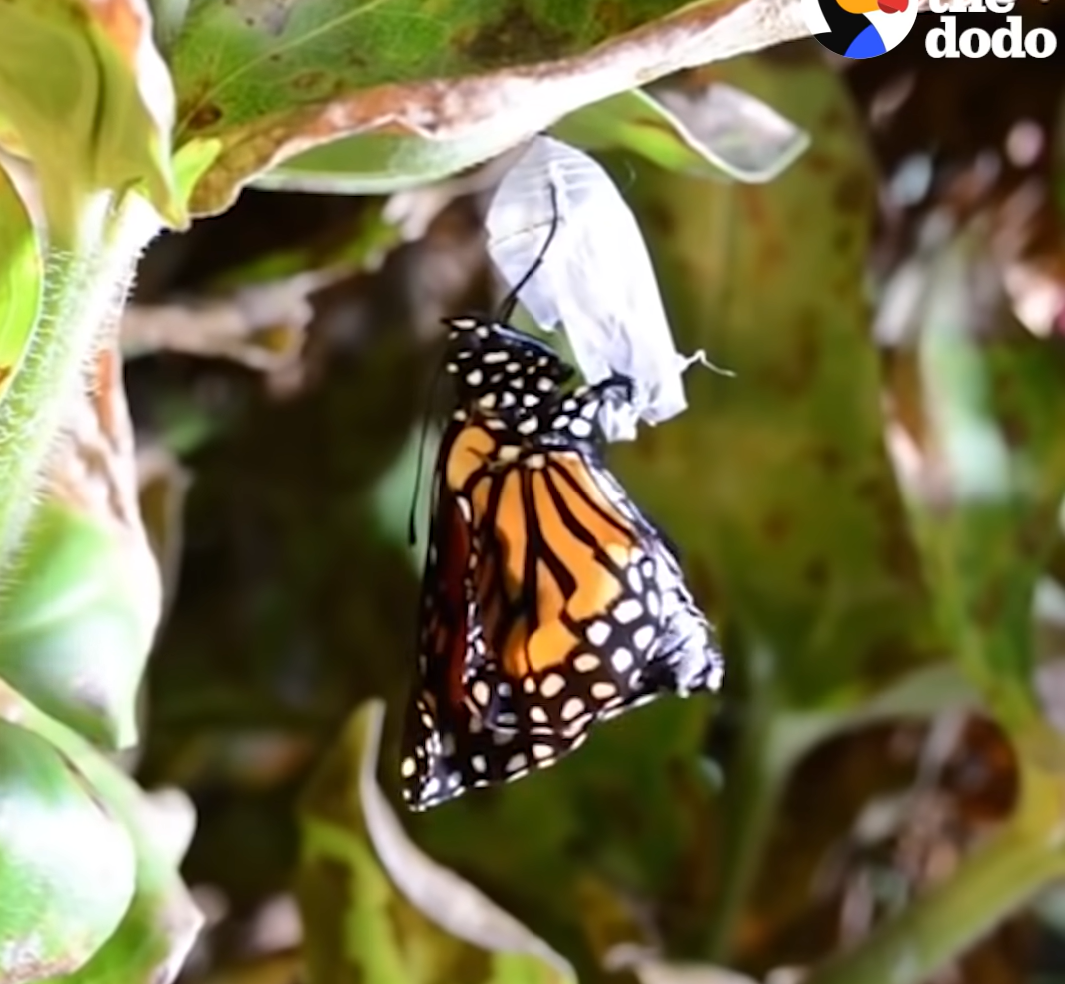

Slide 49


Slide 50
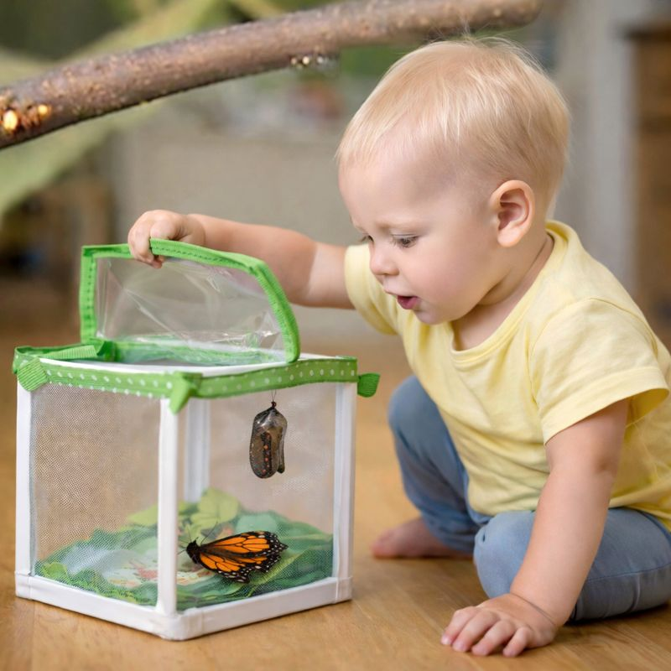

Slide 51
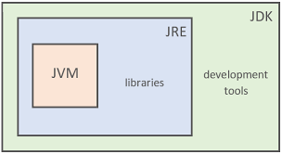
What is JDK,JRE, JVM?

Slide 52


Slide 53


Slide 54


Slide 55

s

Slide 56


Slide 57
